Slide 1
Data science : python for data science
introduction

Slide 2
GET TO KNOW
Am John B. Kilima
Third year student @ CIVE – UDOM and an enterpreneuer—cofounder VR Africa Limited
ISACA student member and ambassador
Passionate in Tech more specific in VR and AR technology
Artificial Intelligence , Blockchain and Cryptocurrencies.
Networking, Computer maintenance and graphics design+ web development

Slide 3



Slide 4
What is data science
In the information age, data is all around us. Within this data are answers to compelling questions across many societal domains (politics, business, science, etc.). But if you had access to a large dataset, would you be able to find the answers you seek?
Data Science give knowledge on how to study and evaluate data sets to provide meaning and decisive value from the data.

Slide 5
WHAT YOU’LL LEARN SPECIFICALLY IN THIS COURSE
Specifically, you’ll learn how to use:
python
jupyter notebooks
A little intro to Numpy
FOR NOW!

Slide 6
WHAT YOU’LL LEARN
Python and Jupyter notebooks as a pre-requisite tool for data science

Slide 7
By learning these skills, you’ll also become a member of a world-wide community which seeks to build data science tools, explore public datasets, and discuss evidence-based findings. Last but not least, this course will provide you with the foundation you need to succeed in later courses in the Data Science.

Slide 8
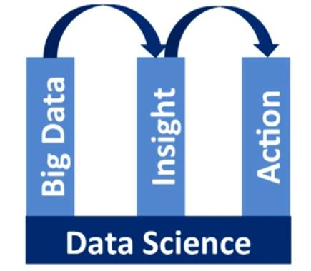
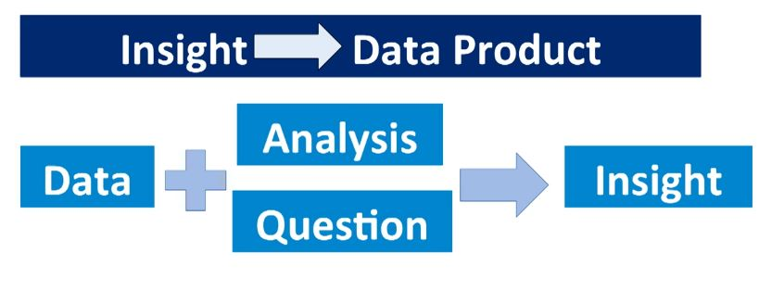
WHAT IS DATA SCIENCE?
Data science turns data into insights or even actions,
but what does that really mean?
Data science can be thought of
as the basis for empirical research,
for data is used to inform our hypotheses
and provide observations.

Slide 9
WHY SUDDEN RISE IN DATA SCIENCE
First, our ability to collect data in real time has ballooned with data coming from a variety of places including real time environmental sensors, websites, smart phones, and a variety of other sources.
In turn, this influx of data has increased demand for large scale data processing. This data growth combined with the advances in storage, networking, and computing at scale has brought us to a new era of data science.
Many dynamic data driven applications in this new era build upon data driven predictions to support decisions, just like the Amazon book prediction example we discussed.
It is nearly impossible to find an industry, scientific discipline, or engineering endeavor today that is not impacted by data science.

Slide 10
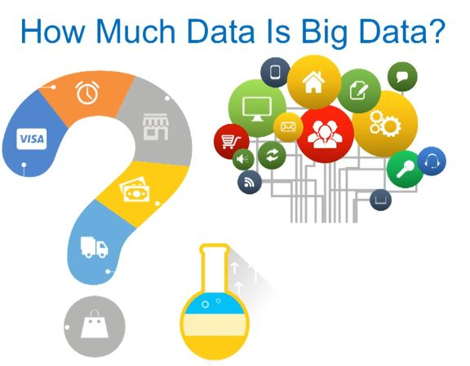

Slide 11
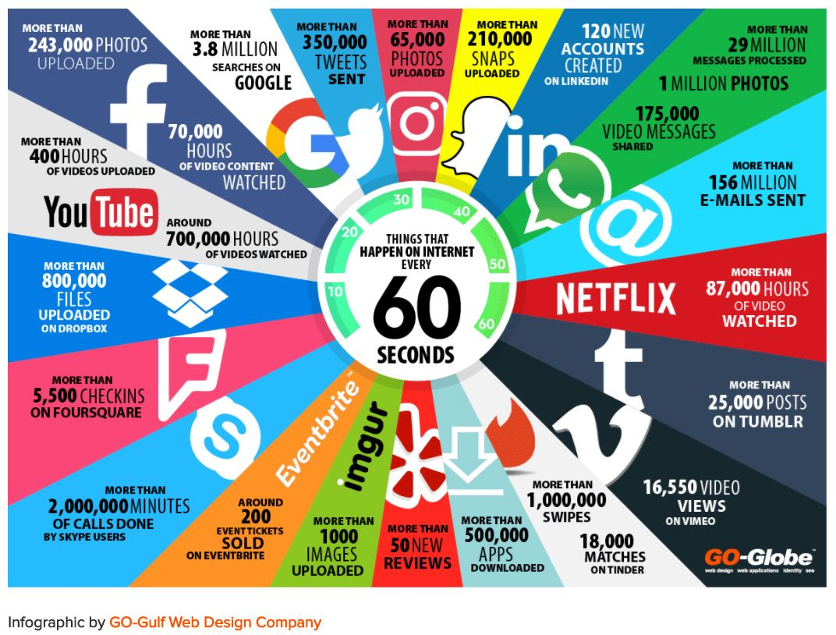
Source: https://www.go-globe.com/blog/things-that-happen-every-60-seconds/
Things that happen on the internet every60 seconds as updated 2017
Another site that can show real-time internet data is
https://www.webpagefx.com/internet-real-time/

Slide 12
While many of us are excited by the opportunities offered by big data, this rapid growth also comes with a number of management and analysis challenges, least of which is information overload.
Our challenges isn't just to manage the data but to try to see how everything is connected. Finding the connections between the kinds of data sets we've discussed has the potential to lead to interesting discoveries.
Such an endeavor requires proper use of data management, data driven methods, scalable tools for dynamic coordination and scalable execution, and a skilled interdisciplinary workforce.
This is where you come in the picture. By putting your time into skills and programming in Python, statistics, machine learning, and big data, you will be ready to take on some of the technical challenges in data science like drug effectiveness analysis, crime pattern detection, and self-driving cars.
As a summary, a data science team often comes together to analyze situations or answer questions in business or science which no single person could solve on their own.
There are lots of moving parts to the solution, but in the end all these parts should come together to provide actionable insight based on data science.
Being able to use evidence based insight in your decisions is more important now than ever.

Slide 13
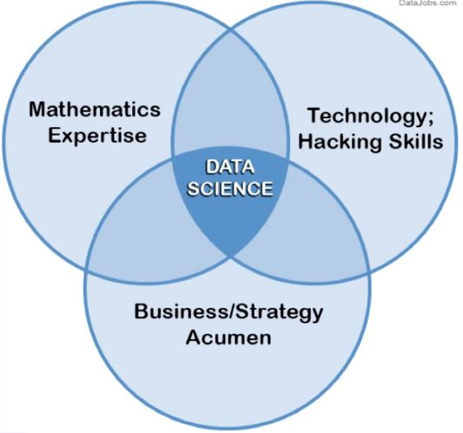
WHO IS A DATA SCIENTIST
Data science happens at the intersection of computer science, mathematics, and business or scientific expertise.

Slide 14
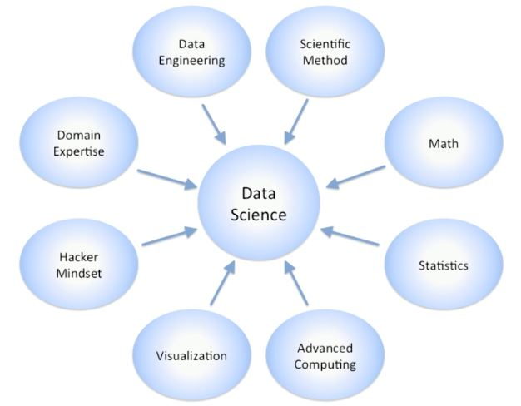
If you zoom deeper into this diagram and open up the sets of expertise, we would see a variation of this figure.
Even at this level, all of these boxes require deeper knowledge and skills in areas like domain expertise, data engineering, statistics, and computing. And even deeper analysis of these skills based on data science job listings would lead you to skills like machine learning, statistical modeling, relational algebra, business passion, problem solving, and data visualization.

Slide 15
That's a lot of skills to have for a single person. Given such a wide range of skills across multiple definitions of data scientists seems impossible.
Therefore data scientists are teams of people who act like one.
This is why we say data science is team sport, referring to the breadth of information and skills it takes to make it happen.
However, there are still common traits to our data scientists.
Data scientists are passionate about the story and meaning behind data, they understand the problem they are trying to solve, and aim to find the right analytical methods to solve this problem.
And they all have an interest in engineering solutions to solve problems.
They also have curiosity about each other's work, and have communications skills to interact within the team and present their ideas and results to others.
These mostly soft skills are very important for success in any data science team.

Slide 16
WHY PYTHON FOR DATA SCIENCE
Easy-to-read and learn
Python is an open language with a vibrant community.
Growing and evolving set of libraries
Data management
Analytical processing
Visualization
Applicable to each step in the data science process.
The Jupyter Notebooks make Python-based analysis more producible and repeatable, as well as provide built-in training and communication support to help with team communication.

